Slide 1
Network topology
Notes:
‹#›

Slide 2
What is Network Topology ?
Network topology is the arrangement of the various elements like links, nodes, etc. of a computer network.
Structure of a network, and may be represented physically or logically.
1

Slide 3
Categories of network topologies:
There are two basic categories of network topologies:
Physical topologies.
Logical topologies.
2

Slide 4
Simple Physical Topologies
The study of network topology recognizes these basic topologies:
Point-to-point
Mesh
Star
Bus
Ring or circular
Tree
Hybrid
3

Slide 5
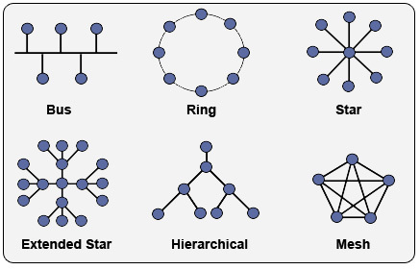
Network Topology
4

Slide 6
Point-to-point topology
The simplest topology is a direct link between two endpoints.
Node
4

Slide 7
Mesh Topology
Every device has a point to point link to every other device.
Two types of mesh topology :
Fully connected.
Partially connected.
5

Slide 8
Mesh Topology
Fully connected: each of the nodes is connected to each other. In graph theory it known as a complete graph.
Node
6

Slide 9
Mesh Topology
Partially connected: some of the nodes of the network are connected to more than one other node in the network with a point-to-point link.
Node
7

Slide 10
Mesh Topology
Advantages:
Data can be transmitted from different devices simultaneously.
Network can be easily expanded.
Message travels along dedicated link, mesh topology is more secure.
Disadvantages:
It is quite expensive since a higher length of cable is required.
Set-up and maintenance of this topology is very difficult.
8

Slide 11
Star Topology
Here each device has a dedicated point-to-point link to the central controller called “Hub”.
There is no direct traffic between devices.
Hub
Node
9

Slide 12
Star Topology
Advantages:
Good options for modern network.
Low start-up cost.
Easy to mange.
Disadvantages:
Too much dependency on central device has its own drawbacks. If it fails whole network goes down.
Difficult to expand.
10

Slide 13
Bus Topology
A bus topology is multipoint.
Here one long cable act as a backbone to link all the devices are connected to the backbone.
Devices share responsibility for getting data from one point to another.
Node
Terminator
11

Slide 14
Bus Topology
Advantages:
Works well for small networks.
Easy to add to it.
Relatively inexpensive to implement.
Disadvantages:
Difficult to administer/troubleshoot.
Limited cable length
Maintenance costs higher in the long run.
12

Slide 15
Ring Topology
Here each device has a dedicated connection with two devices on either side.
The signal is passed in one direction from device to device.
Node
13

Slide 16
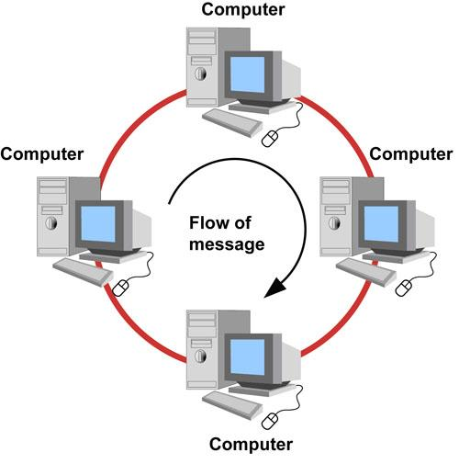
Ring Topology
14

Slide 17
Ring Topology
Advantages:
Easy to install.
Handles high volume networks traffic.
Short cable length.
Disadvantages:
Network is highly dependent on the wire which connects different components.
Break in a single ring can break entire network.
15

Slide 18
Tree Topology
Tree topology is one of the most common network setups that is similar to a bus topology and a star topology.
Here nodes are linked in a stage or phase.
Node
16

Slide 19
Tree Topology
Advantages:
The tree topology is useful in cases where a star or bus cannot be implemented individually.
The network can be expanded by the addition of secondary nodes.
Short cable length.
Disadvantages:
Multiple segments are connected to a central bus, the network depends heavily on the bus. Its failure the entire network will be down.
16

Slide 20
Hybrid Topology
A network which contain all type of physical structure and connected under a single backbone channel.
Hybrid networks use a combination of any two or more topologies (e.g., bus, star, ring, etc.)
17

Slide 21
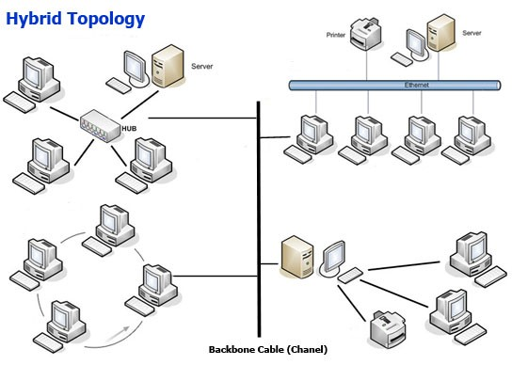
Hybrid Topology
18

Slide 22
printer
server

Slide 23
Considerations for choosing topology
Money-Bus n/w may be the least expensive way to install a n/w.
Length-of cable needed- the linear bus n/w uses shorter lengths of cable.
Future growth-with star topology, expending a n/w is easily done by adding another devices.
Cable type-most common used cable in commercial organization is twisted pair. Which often used with star topologies.
Full mesh topology is theoretically the best since every device is connected to every other device.
Next best would be tree topology, which is basically a connection of star.
20

